Slide 1

CAPSTONE PROJECT 2 Fraud Detection on BANK CARD Payments

Slide 2
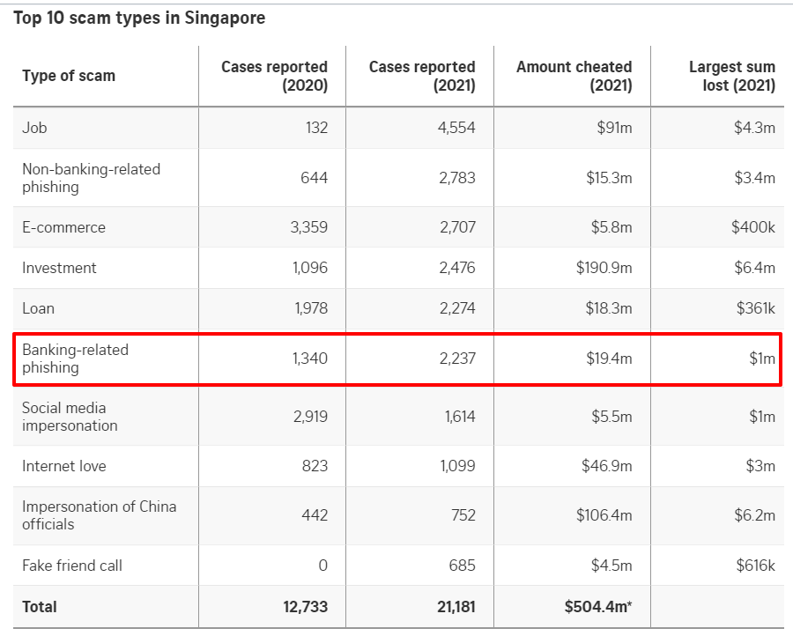
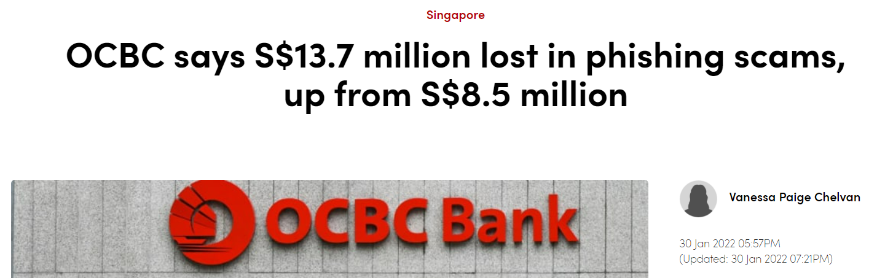

Slide 3
Summary of dataset
BankSim is an agent-based simulator of bank payments based on a sample of aggregated transactional data provided by a bank in Spain.
180 STEPS OVER 6 Months. Thieves ARE INJECTED to steal an average of 3 cards per step and perform about 2 fraudulent transactions per day. PRODUCING 594,643 records in total.
10 Columns OF DATA
https://www.kaggle.com/datasets/ealaxi/banksim1

Slide 4
Stakeholders
Bank IT Security Managers & Customer Relations
analysis to be drawn from this data:
Fraud Amounts & Counts
Fraud Target Analysis based on demographics
Type of expenses
Gender
Age Group
List of customers on high-risk alert

Slide 5
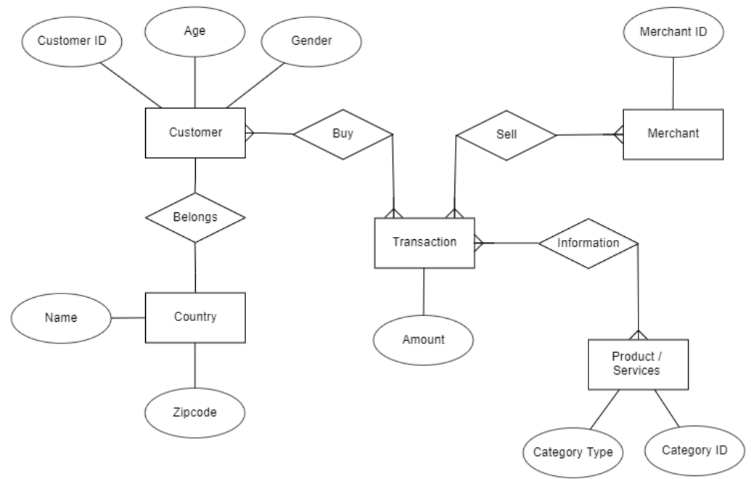
ER DIAGRAM

Slide 6
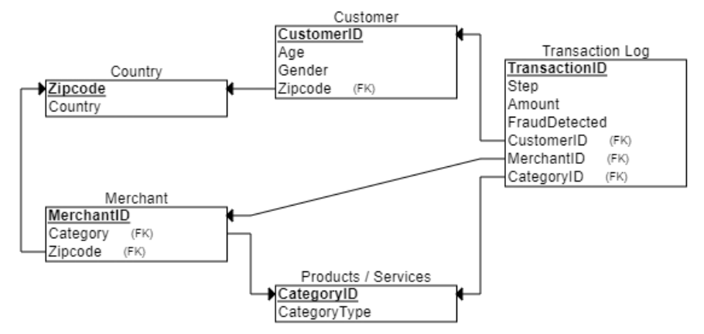
DATABASE SCHEMA

Slide 7
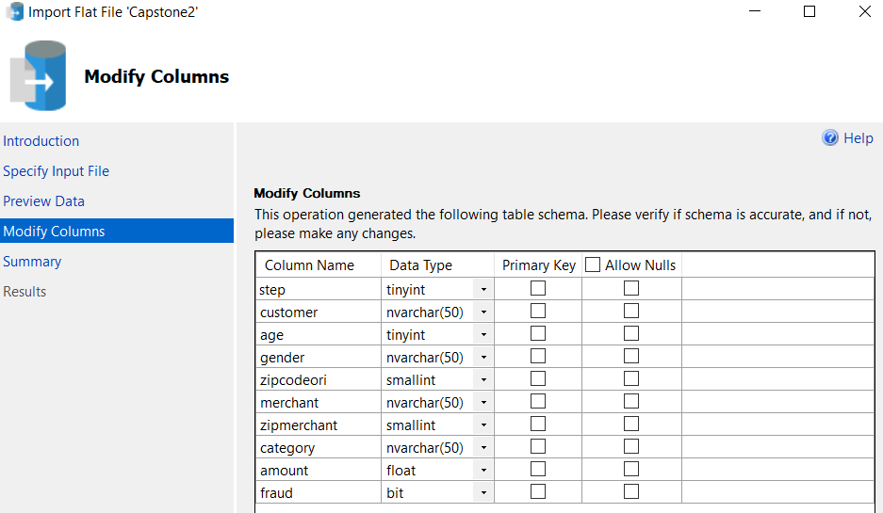
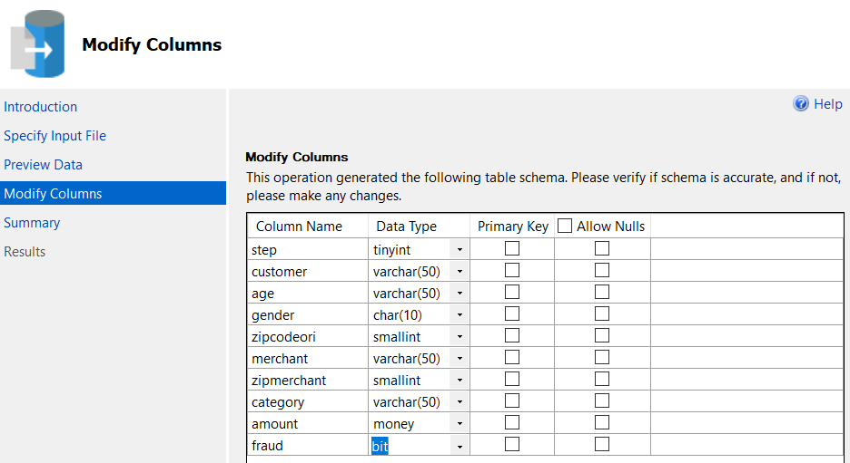
MODIFYING DATA TYPES

Slide 8
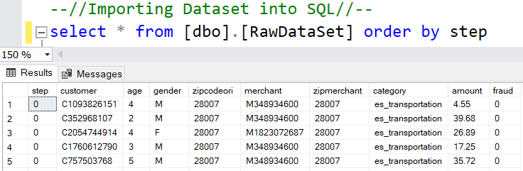
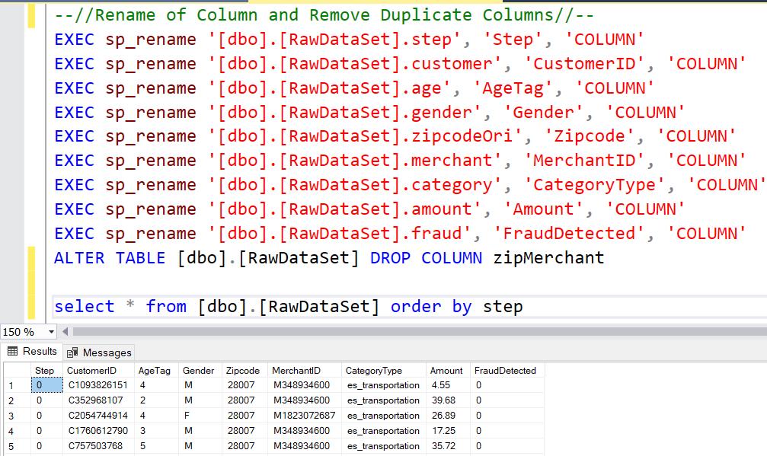
Renaming the columns of raw dataset

Slide 9
DATA NORMALIZING - CREATE DIFFERENT TABLES
Raw Dataset
Customer Table
Merchant Table
Country Table
Transaction Log Table
Product & Services Table

Slide 10
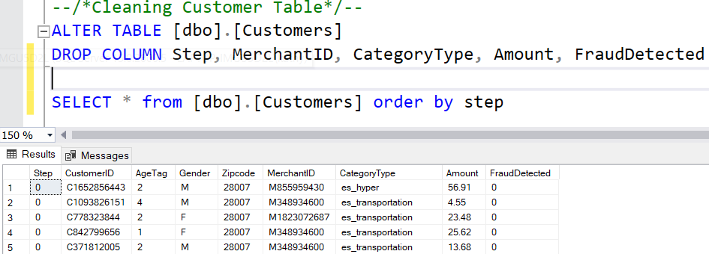
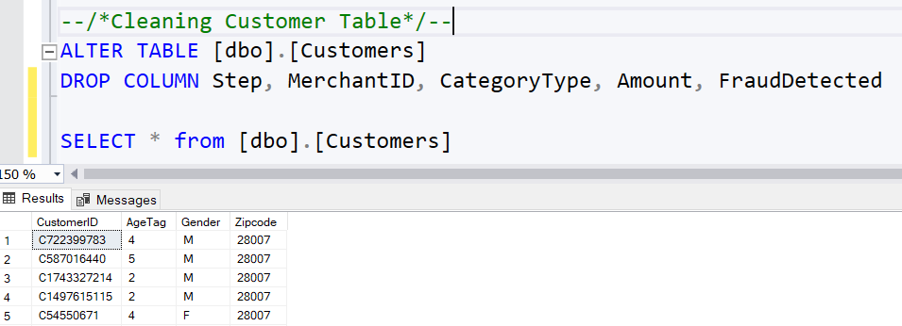
CREATING CUSTOMER TABLE

Slide 11
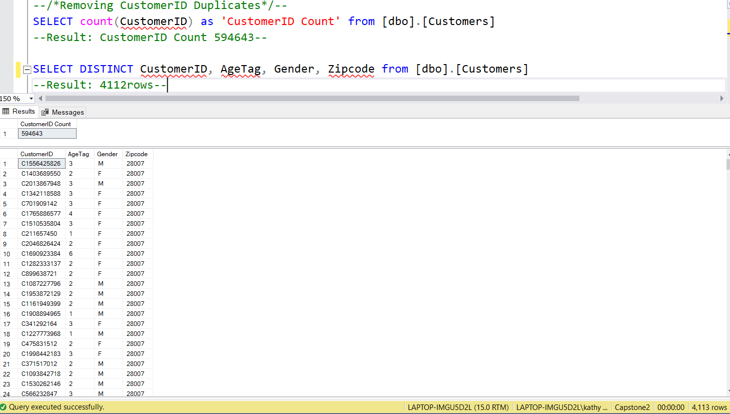
Removing DUPLICATE CUSTOMER IDs

Slide 12
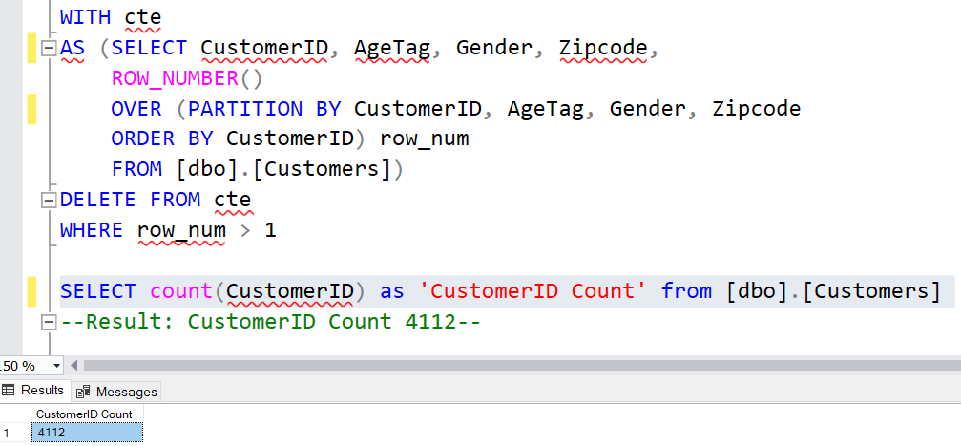
Removing DUPLICATE CUSTOMER IDs

Slide 13
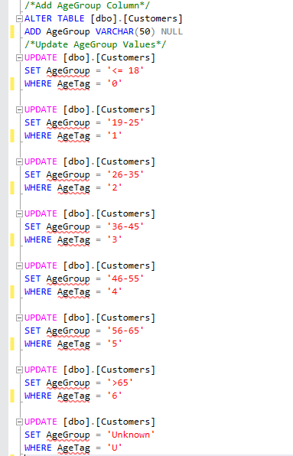
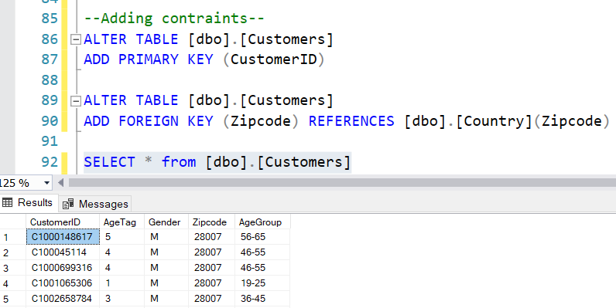
ADDING AGE GROUP COLUMN & CONSTRAINTS

Slide 14
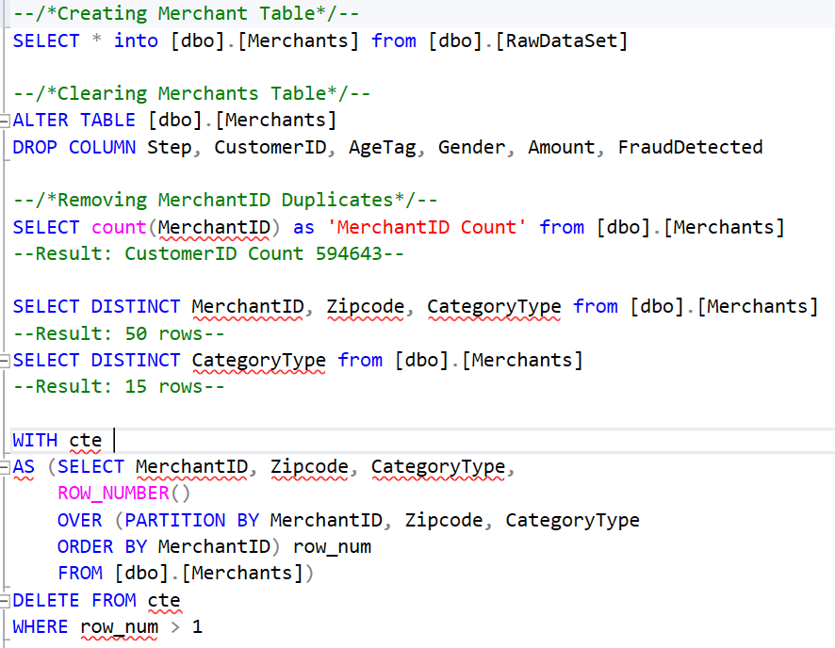
CREATING MERCHANT TABLE
Removing DUPLICATE MERCHANT IDs

Slide 15
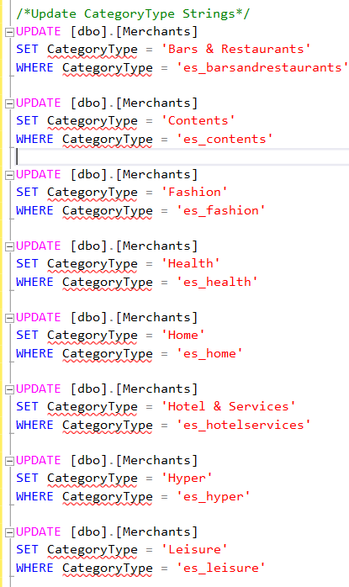
UPDATE CATEGORY TYPE STRING

Slide 16
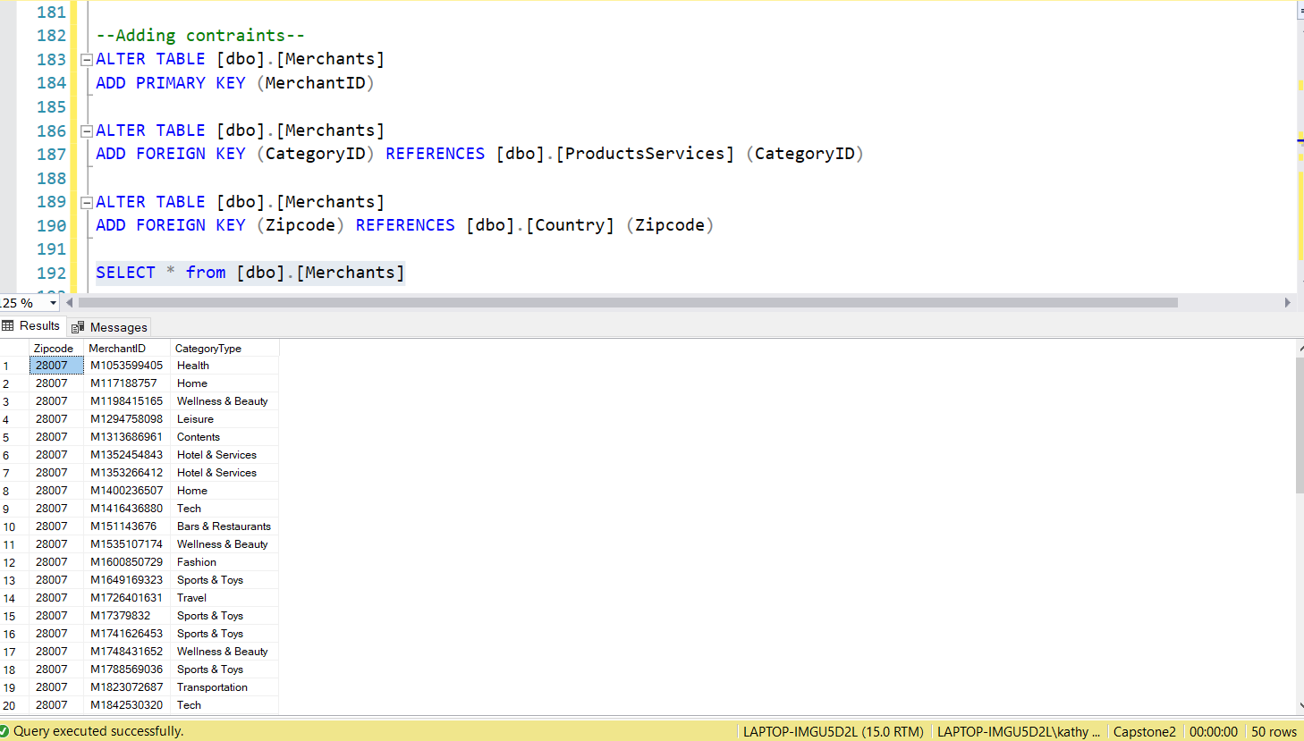
Adding CONSTRAINTS

Slide 17
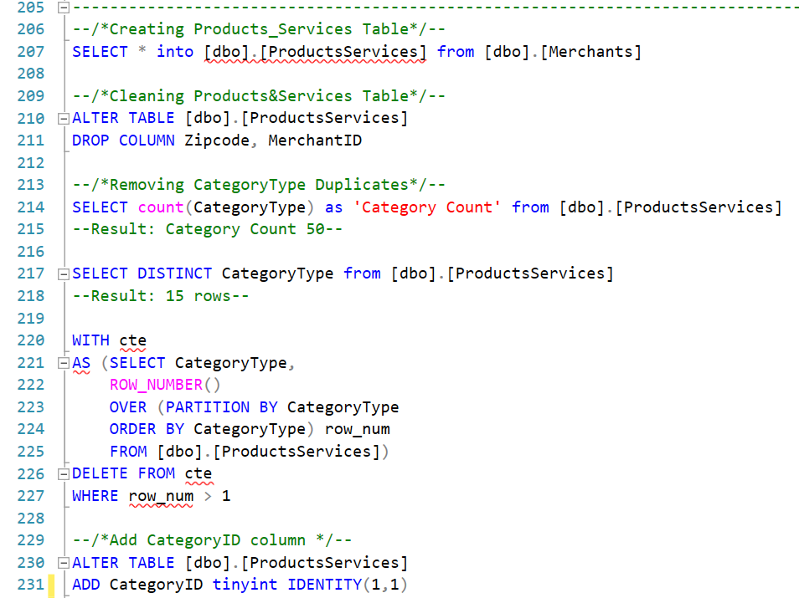
CREATING Products & Services Table
Removing DUPLICATE CATEGORY TYPES

Slide 18
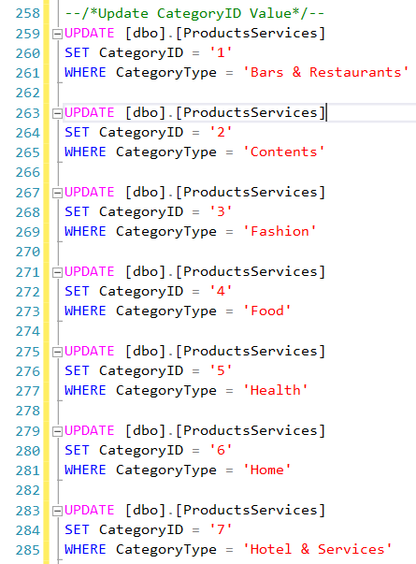
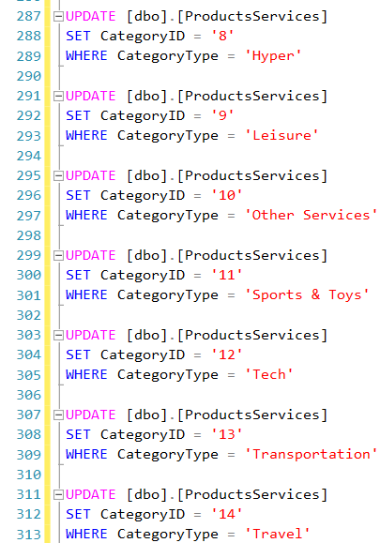
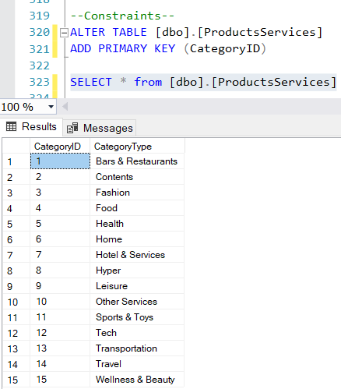
Update category IDS & ADDING CONTRAINTS

Slide 19
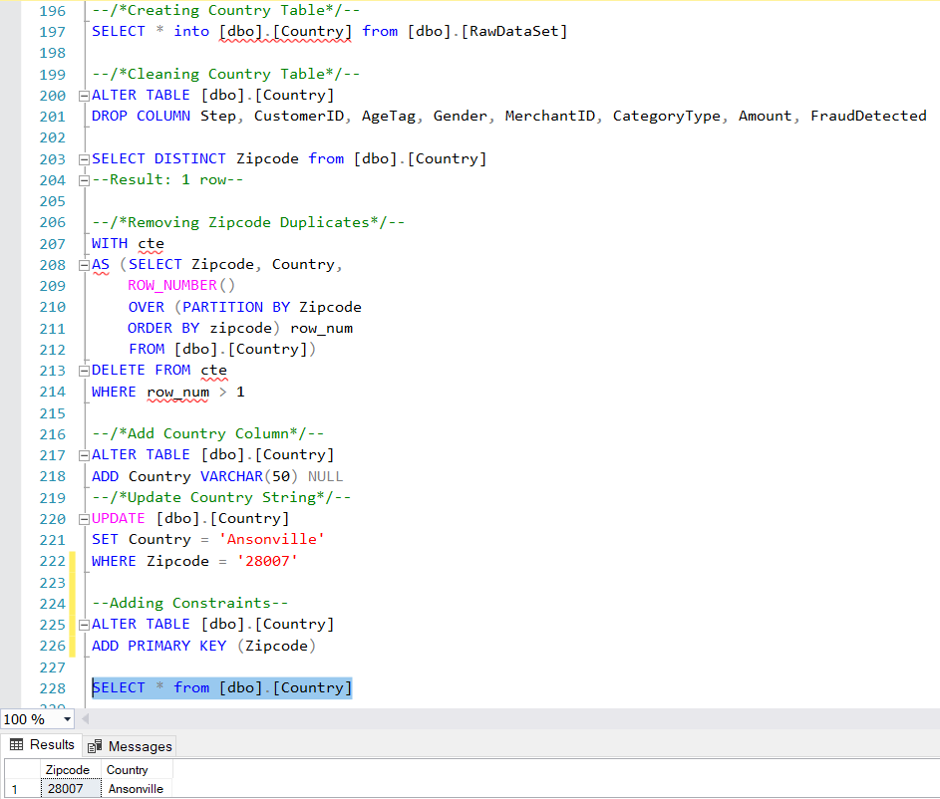
Creating Country TABLE

Slide 20
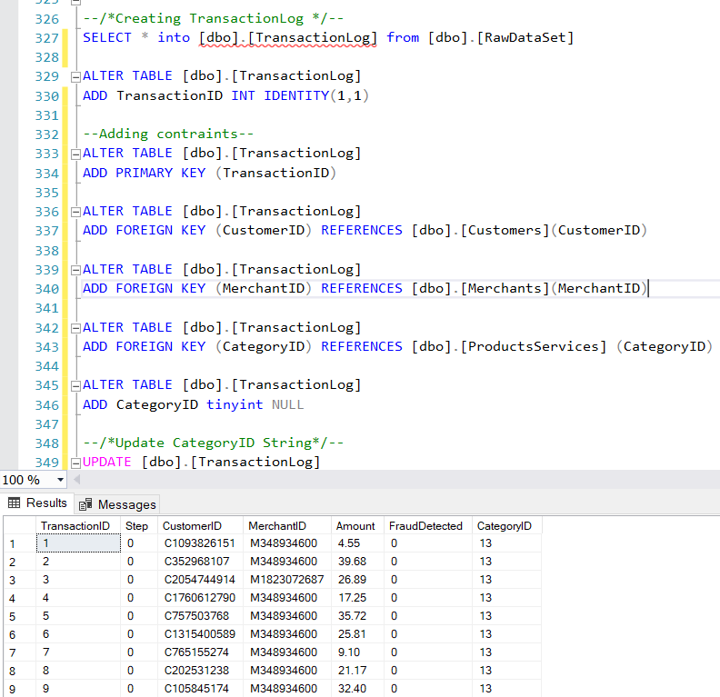
Creating TRANSACTION LOG TABLE

Slide 21
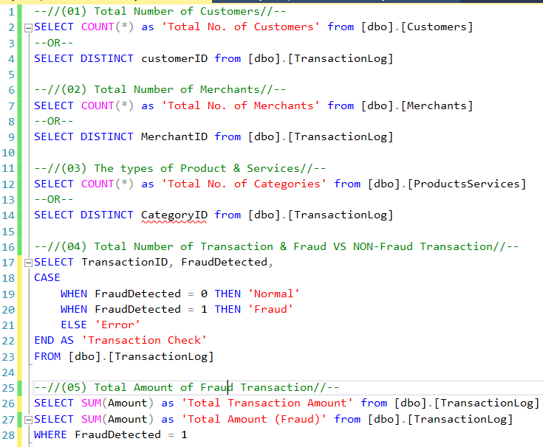
QUERIES

Slide 22
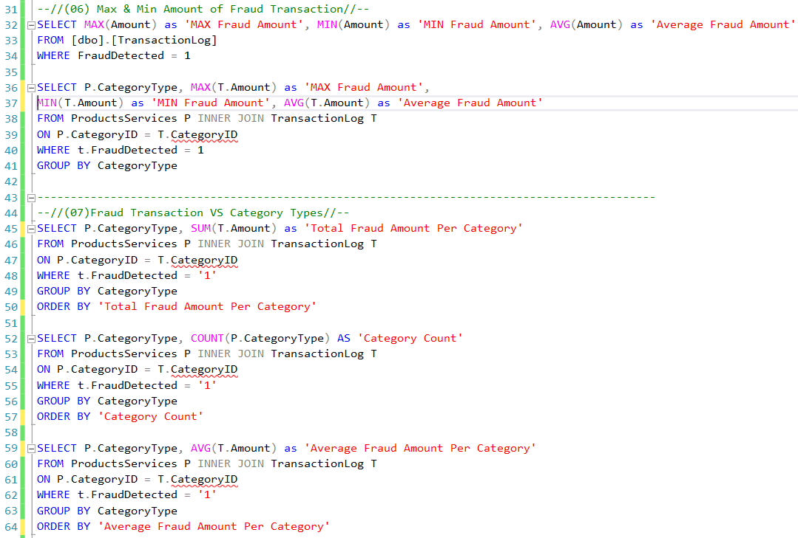
Fraud Amount & CATEGORY TYPES ANALYSIS

Slide 23
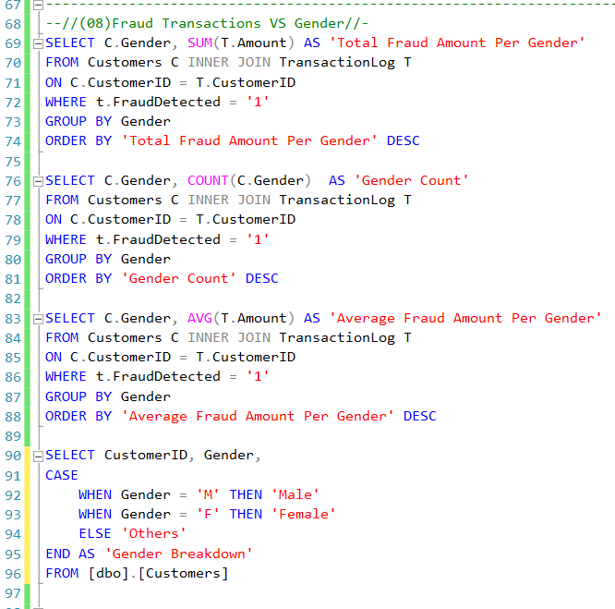
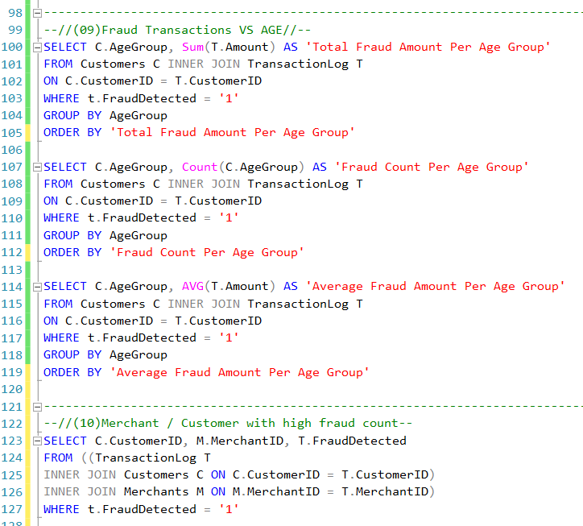
GENDER & AGE GROUP FRAUD ANALYSIS

Slide 24
CONCLUSIONS
Fraudulent transactions are less in count but more in amount.
Fraud Count (Number of Fraud Transactions/ Total No. of Transactions) - 1%
Fraud Amount (Amount of Fraud Transactions / Total Amount of Transactions) - 17%
Travel, Health and Sports & Toys are the top 3 most targeted categories for fraudsters.
There is no clear data justification that Fraudsters will target female more than male users. Sampling data has more female than male users.
Age Group of “26 – 25” has the highest amount fraud transaction activity, “<=18” highest average amount of fraud transaction.

Slide 25
recommendations
Bank to raise awareness and educate the public via campaigns, SMS, Email and Newsletters.
Theft / Card skinning / Unauthorized Survey / Phishing Websites, Emails, SMS, Ads
For huge transaction amount, implement 2 factor authentication security. Follow by SMS/Email notifications to customers.
Merchant to notify customers actively when order is confirmed.
Incorporate child safety control app for young kids, to protect them from online predators. Set a limit control for supplementary cards.

Slide 26

Thank you

